Slide 1
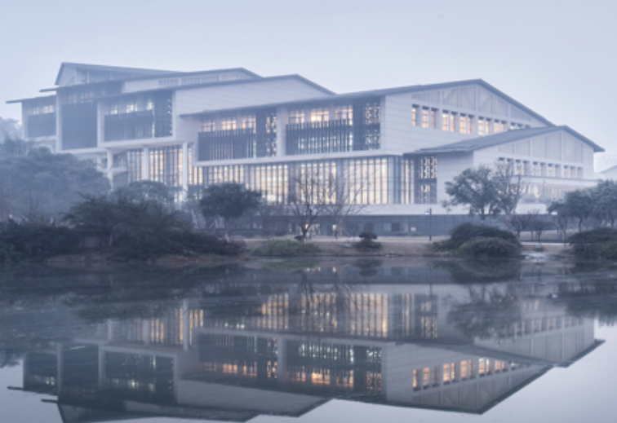
Chongqing University of Technology
ATAI
Advanced Technique of Artificial Intelligence
Chongqing University of Technology
Unsupervised Paraphrasing via Deep Reinforcement Learning
2020 KDD
彭展望

Slide 2
Outline
Introduction
Related Work
Method
Experiment
Conclusion
Notes:
hahah

Slide 3
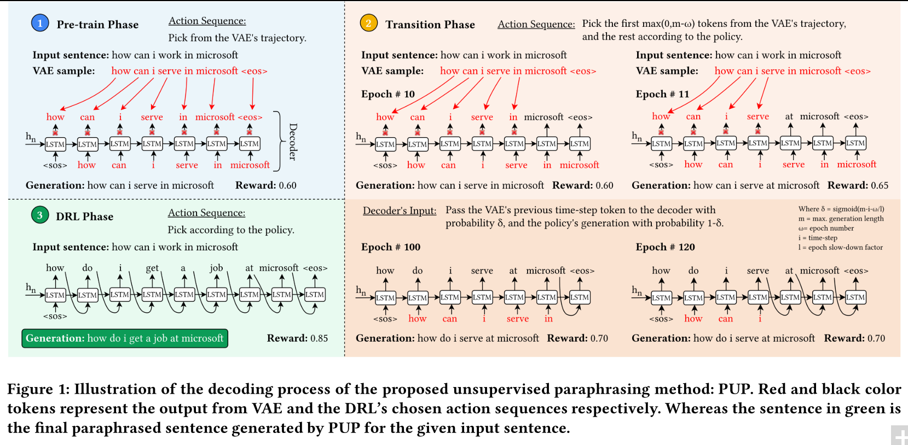
Introduction

Slide 4
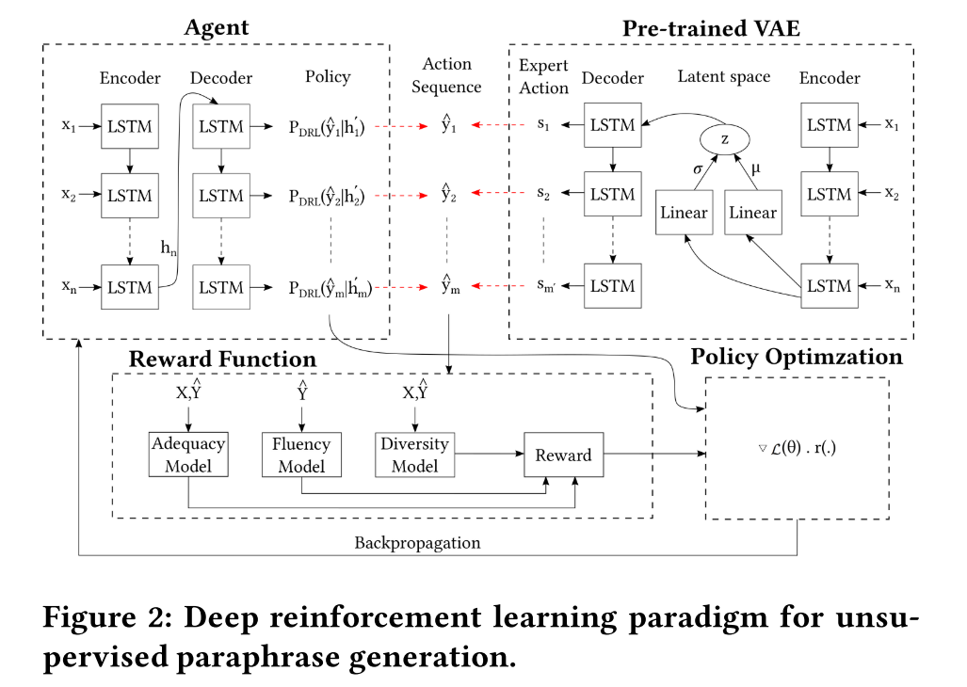
Method

Slide 5
Method
Encoder-Decoder Framework
input sequence
generate a target sequence
VAE: Variational Autoencoder:
loss function:
论文：Generating sentences from a continuous space
论文：Auto-encoding variational bayes
论文：Stochastic backpropagation and approximate inference in deep generative models.

Slide 6
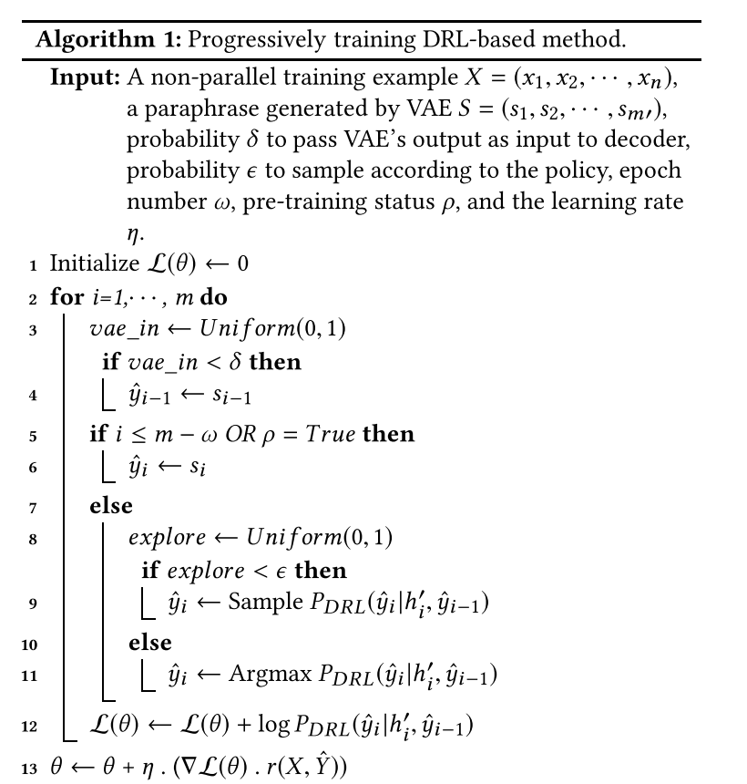
Method
where m is the length of the output sentence, ω is the epoch number, and l is the slowdown factor to decay the probability δ as ω grows.
Loss function:
求导：

Slide 7
Method
Paraphrasing Reward
Language Fluency:
We use a pre-trained CoLA [45] to score our generated paraphrased sequences $\hat{Y}$.
论文：Neural network acceptability judgments.
Semantic Adequacy:
使用 a deep averaging network (DAN) encoder 生成

Slide 8
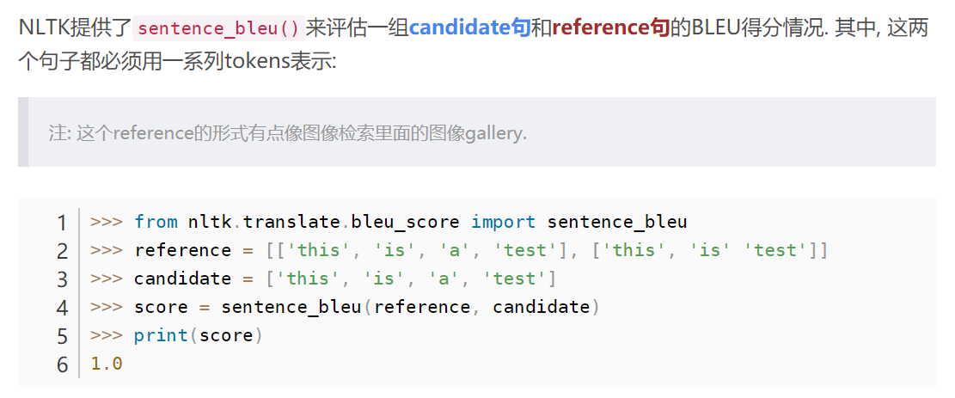
Method
Paraphrasing Reward
Expression Diversity:
=

Slide 9
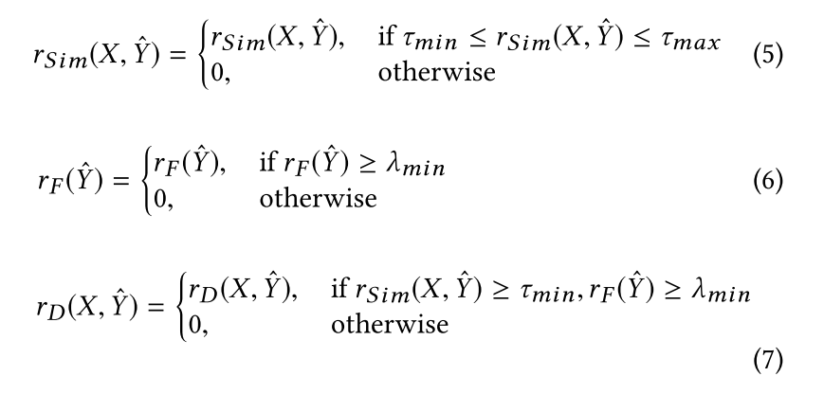
Method
Paraphrasing Reward

Slide 10
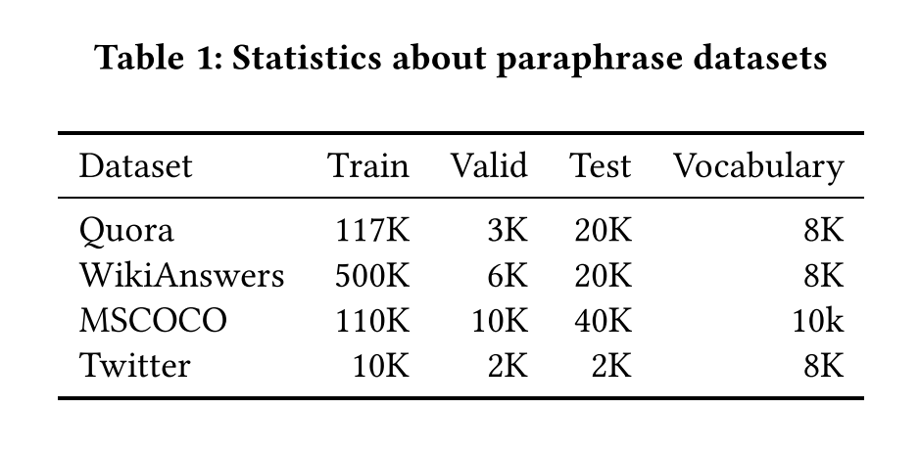
Dataset

Slide 11
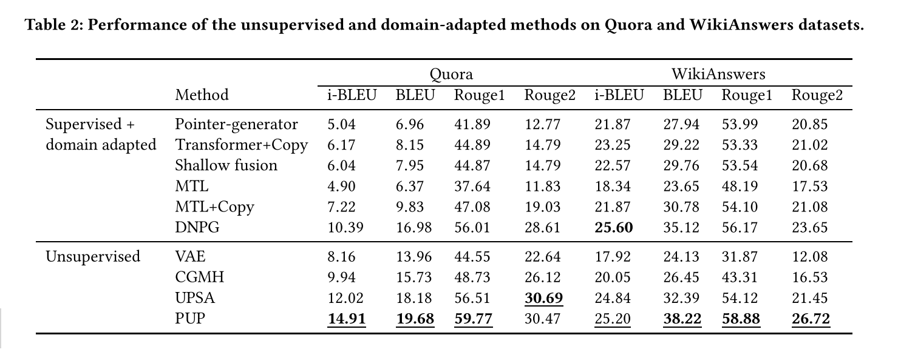
Experiment
where s is the input sentence, $r_{s}$ represents the reference paraphrases

Slide 12
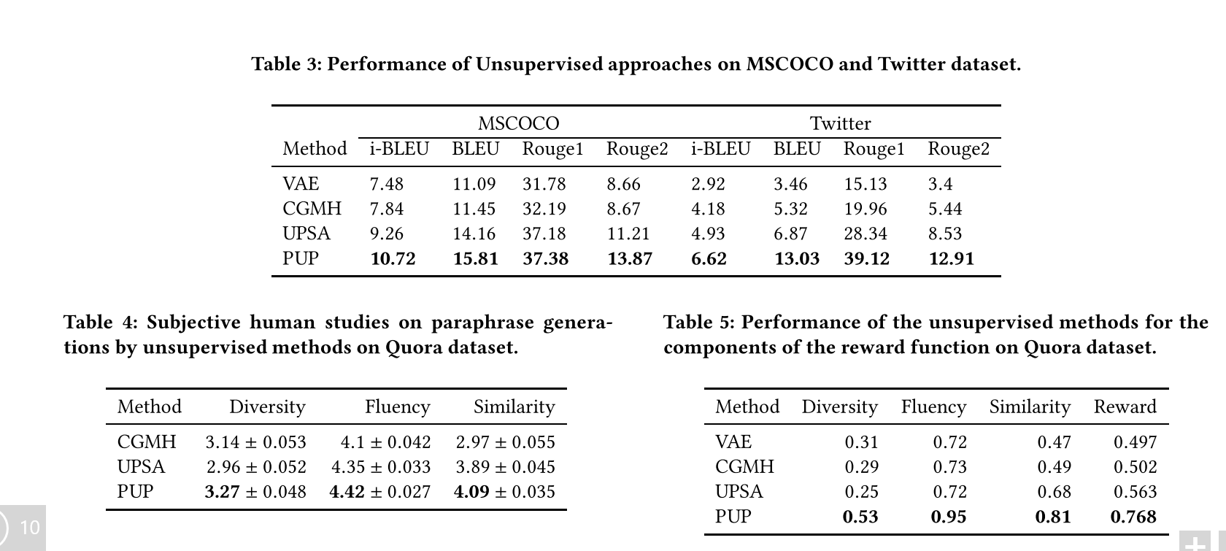
Experiment

Slide 13
Experiment

Slide 14
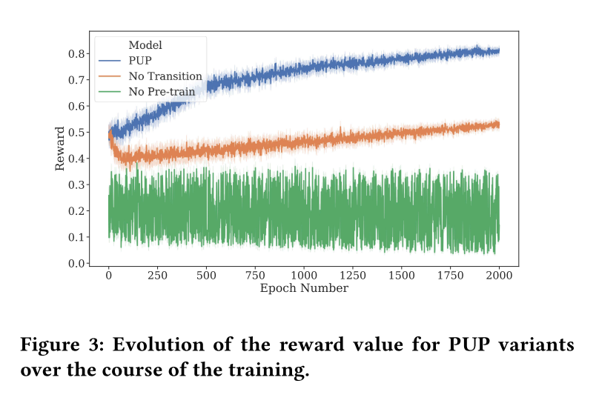
Experiment

Slide 15
Thanks

